Slide 1
FIBERONE TECH ACADEMY
Fundamentals of the Optical Fiber (FTTH)
JULY, 2025
EMMANUEL BABALOLA, HEAD SD MAINLAND WEST.

Slide 2

Contents
The following will be learned at the end of this module:
  What Is Fiber Optics?
  Characteristics of the Fiber Optic Cables
  Fiber Advantages and Disadvantages
  Transmission media
  Why fiber over other transmission media
  Fiber Optic Installation Safety Rules
  How Optical Fiber Is Made
  Fiber Design
  How Fiber Works
  Fiber Types
  Optical Fiber Parameters
  Fiber optic color code chart,
  Introduction to FTTH

Slide 3
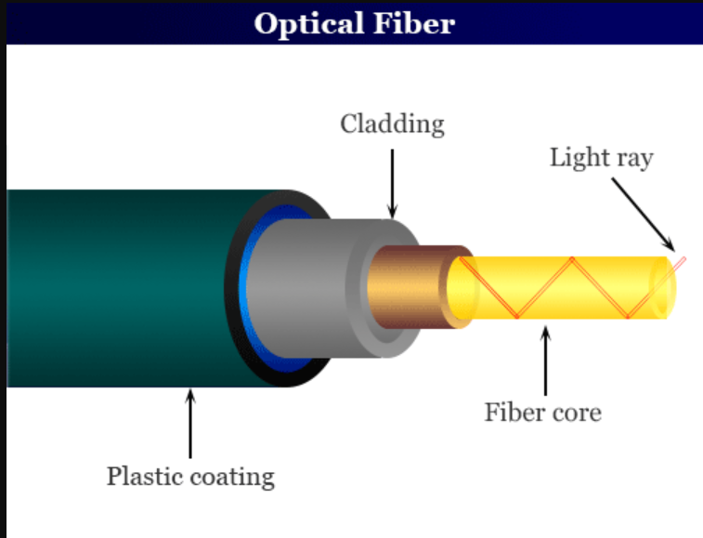
WHAT IS FIBER OPTICS?
In its simplest terms, fiber optics is the technology of using “waveguides” to transport information from one point to another in the form of light. Fiber optic communications is based on the principle that light in a glass medium can carry more information over longer distances than electrical signals can carry in a copper or coaxial medium. The purity of today's glass fiber, combined with improved system electronics, enables fiber to transmit digitized light signals well beyond 100 km (60 miles) without amplification. With few transmission losses, low interference, and high bandwidth potential, optical fiber is an ideal transmission medium Fiber.

Slide 4
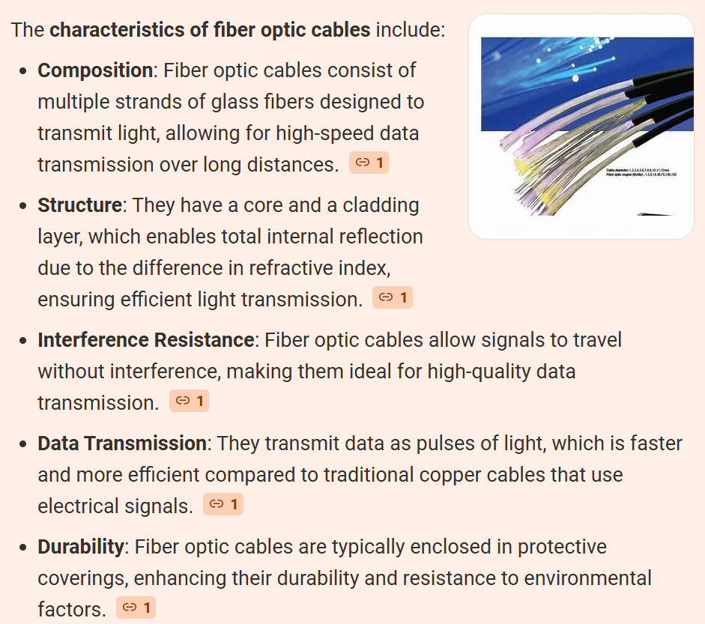

Slide 5
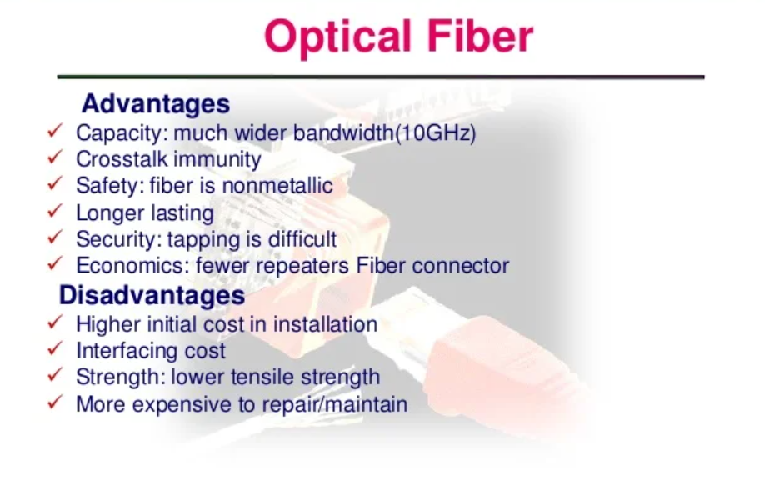

Slide 6
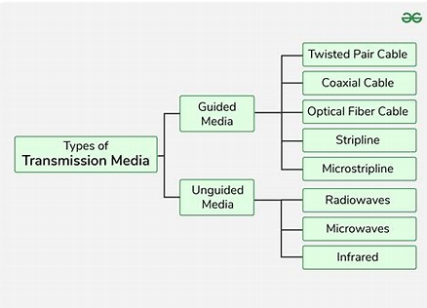
Transmission media

Slide 7
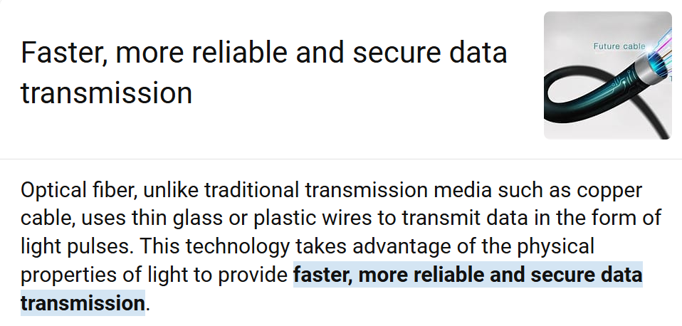
WHY FIBER OVER OTHER TRANSMISSION MEDIA

Slide 8
FIBER OPTIC HANDLING SAFETY RULES
1. Keep all food and beverages out of the work area. If fiber particles are ingested, they can cause internal hemorrhaging.
2. Wear aprons to minimize fiber particles getting on your clothing. Fiber particles on your clothing can later get into food, and drinks, and/or be ingested by other means.
3. Always wear safety glasses with side shields. Treat fiber optic splinters the same as you would glass splinters.
4. Never look directly at the end of fiber cables until you are positive that there is no active source at the other end. Since the light is infrared, you can't see it.
5. Before inspecting a connector with a fiber optic microscope, ensure that the fiber is not active - a microscope can increase the danger associated with high-powered light sources by focusing the light from a fiber into your eye.
6. Only work in well-ventilated areas - never splice in a manhole!
7. Contact wearers must not handle their lenses until they have thoroughly washed their hands.
8. Do not touch your eyes while working with fiber optic cables until they have been thoroughly washed.
9. Keep all combustible materials well away from the splicing area. 10. Account for all fiber shards and discard them in a safe place.
11. Thoroughly clean your work area when you are done.
12. Do not smoke while working with fiber optic systems.
13. Installation of fiber optics may require the use of chemicals that can be considered hazardous. To ensure chemicals are used properly, always consult the Material Safety Data Sheet (MSDS).

Slide 9
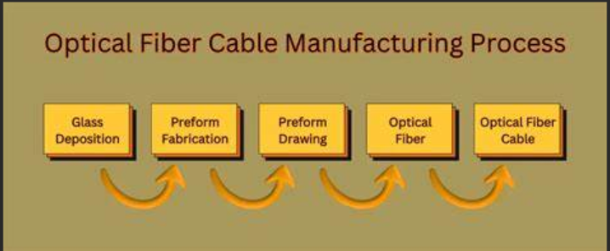
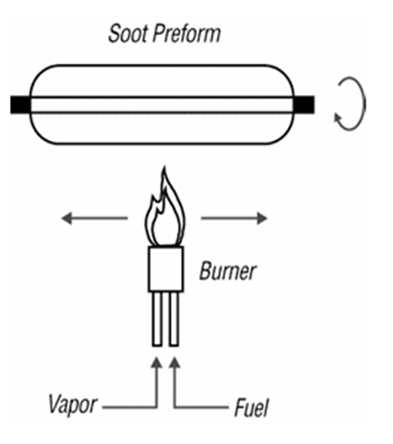
HOW OPTICAL FIBER IS MADE
There are two main steps in the process of converting raw materials into optical fiber ready to be shipped. 1. Making the preform and 2. Drawing the perform.
1. There are several methods used to make preforms. In the Modified Chemical Vapor Deposition (MCVD) process, the highly controlled mixture of chemicals described below is passed through the inside of a rotating glass tube made of pure synthetic SiO2. A hollow glass tube approximately 40 cm in length known as a "preform" is placed horizontally and rotated slowly on a lathe, and gases such as silicon tetrachloride (SiCl4) or germanium tetrachloride (GeCl4) are injected with oxygen at the end of the tube. The gases are then heated using an external hydrogen burner. As the gasses flow inside the tube, they react to the heat by forming solid submicron particles, called "soot," in the vicinity of the heat zone. Once the soot is formed, it is deposited on the inner wall of the tube. The deposited material will form the core region of the optical fiber. The process is repeated for many hours as each subsequent core layer is formed. For every sweep of the burner, the manufacturer can modify the composition, viscosity, and thickness of the deposited layer to produce specific fiber designs. After the desired amount of core material is deposited the chemical flow is eliminated, the speed of the torch is decreased, and the temperature of the flame is increased so that the tube collapses into a solid rod.

Slide 10
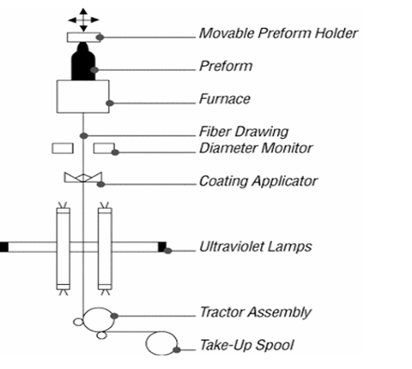
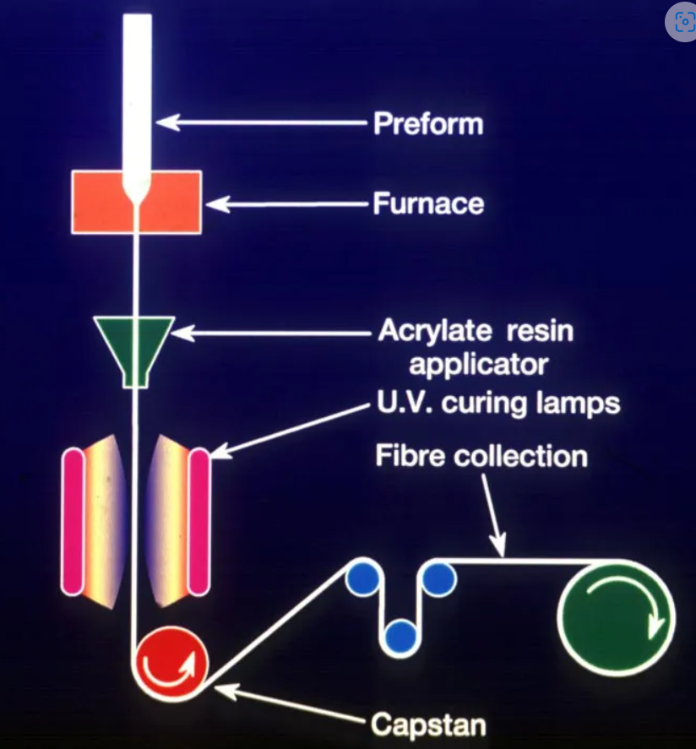
HOW OPTICAL FIBER IS MADE
2. Preform drawing. The tip of the preform is lowered into a high-purity graphite furnace. Pure gases are injected into the furnace to provide a clean and conductive atmosphere. In the furnace, tightly controlled temperatures approaching 1900°C soften the tip of the preform. Once the softening point of the preform tip is reached, gravity takes over and allows a molten gob to "free fall" until it has been stretched into a thin strand. During the draw, the preform is heated at the optimum temperature to achieve an ideal drawing tension. Draw speeds of 10 - 20 meters per second are not uncommon. The fiber goes through a precise on-line diameter monitor to ensure a specified outside diameter. Next, coatings are applied and cured, using ultraviolet lamps. At the bottom of the draw, the fiber is wound on spools.

Slide 11
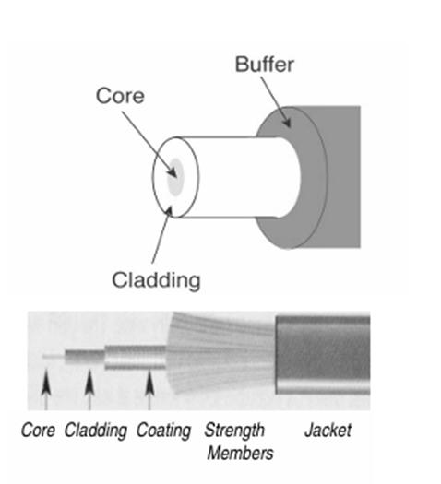
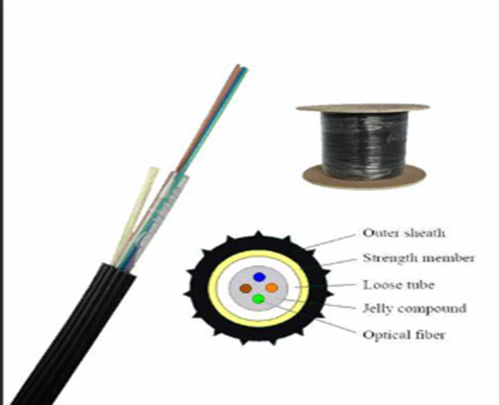
FIBER DESIGN
Core, Cladding, and Coating: An optical fiber consists of two different types of highly pure, solid glass, composed to form the core and cladding. A protective acrylate coating then surrounds the cladding. In most cases, the protective coating is a dual-layer composition. Core: The light-conducting central portion of an optical fiber composed of material with a higher index of refraction than the cladding. The portion of the fiber that transmits light. Contrary to myth, the core does not have a hole in the middle but is completely solid throughout. Cladding: (Cannot be removed!) The outside optical layer of the fiber that traps the light in the core and guides it along, even through curves. Buffer coating or primary coating is removed during stripping. A hard plastic coating on the outside of the fiber that protects the glass from moisture or physical damage. Loose Tube = 250 microns & Tight Buffer = 900 microns. Strength members: Aramid fibers (Kevlar®: A very strong, very light, synthetic compound developed by DuPont), which are used to pull the cable. The term is also used for the fiberglass rod in some cables used to stiffen them to prevent kinking.

Slide 12
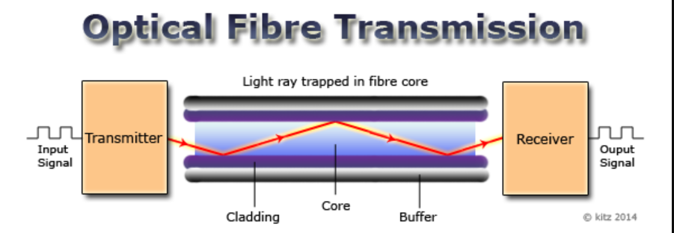

Slide 13
HOW FIBER WORKS
The operation of an optical fiber is based on the principle of total internal reflection. Light reflects (bounces back) or refracts (alters its direction), depending on the angle at which it strikes a surface. This reflection is usually caused by creating a higher refractive index in the core of the glass than in the surrounding cladding glass, creating a “waveguide of sorts.” The refractive index of the core is increased by marginally modifying the composition of the core glass, generally by adding small amounts of a dopant. Typical values of refractive index are 1.47 for the core and 1.46 for the cladding.
Refraction: light changes direction, but without reflecting from a surface. Reflection: light bounces off of the surface and starts traveling abruptly in a very different direction. Total Internal Reflection: The speed of light is determined by the medium in which it is traveling. The index of refraction (ir) for a material is expressed as the ratio of the speed of light in a vacuum (c) to the speed of light in the material (v), where ir = c/v. Values of ir are 1.47 for the core and 1.46 for the cladding. Light traveling across an interface from a higher refractive index medium (core) to a lower refractive index medium (cladding) will bend away from the normal. This has a pretty cool implication: at some angle, known as the critical angle c light traveling from a higher refractive index medium to a lower refractive index medium will be refracted at 90° - along the interface. If the light hits the cladding at any angle larger than this critical angle, it will not pass through at all. Instead, it will be reflected into the core, a process known as total internal reflection. So, light waves bend (refract) or bounce (reflect) when they meet the boundary between two materials with different indices of refraction. The angle at which the light strikes the boundary effects the amount and direction of light that is refracted or reflected. Oh, by the way, light reflected from a glass-air boundary is called a Fresnel reflection.

Slide 14
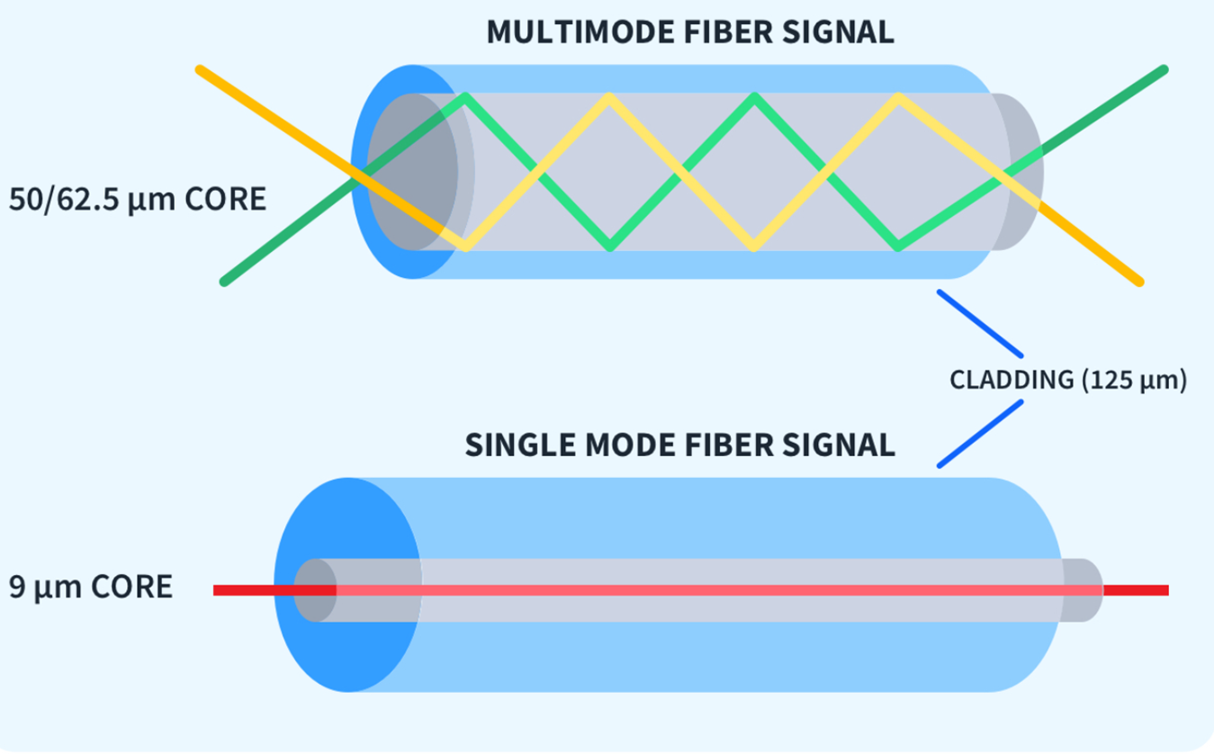
FIBER TYPES

Slide 15
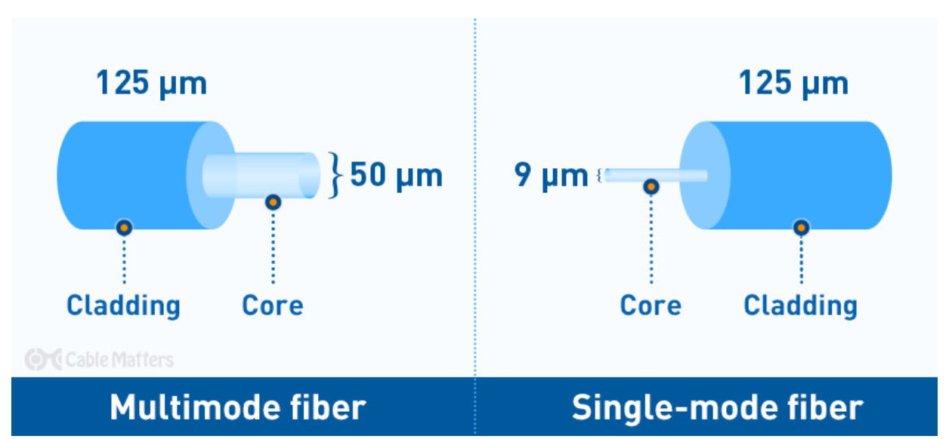
Differences between single mode and multimode fiber optics

Slide 16
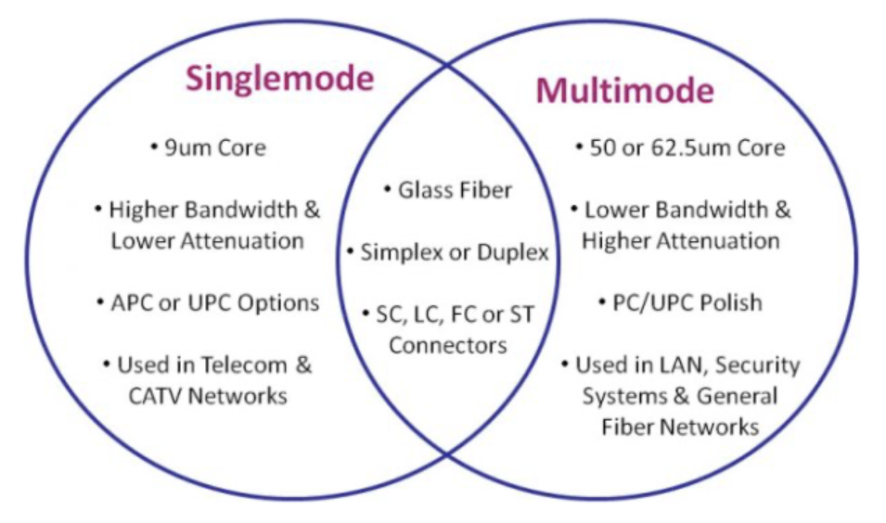
Differences between single-mode and multimode fiber optics

Slide 17
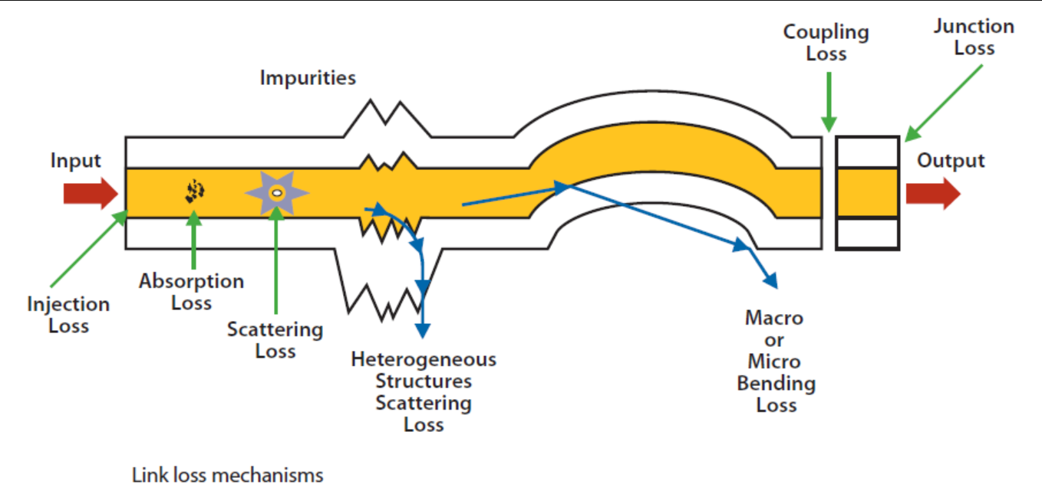
1. CHANNEL OR LINK LOSS
Channel or link loss is the total path loss or attenuation between the transmitter and receiver is the sum of various loss mechanisms: scattering, micro bending, macro bending, and interconnection. These limit the maximum system length, and the number of connections allowed.

Slide 18
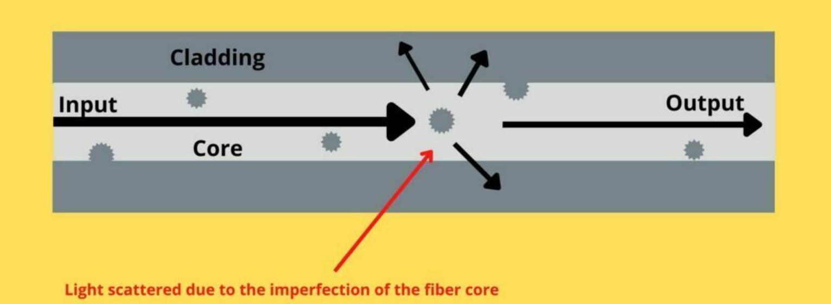
2. SCATTERING
Scattering causes the intrinsic fiber loss, dominated by what is known as Rayleigh scattering, which results from variations in the density and composition of the glass. This loss varies with the wavelengths of light applied.

Slide 19
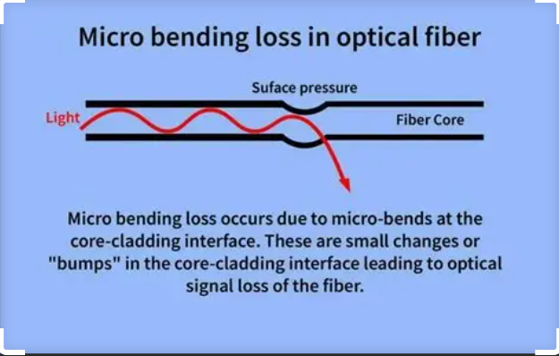
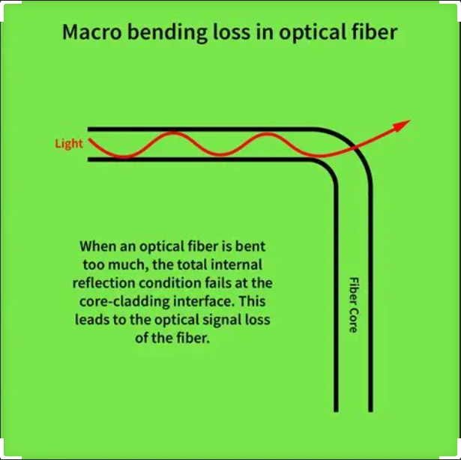
3. MICROBENDS AND MACROBENDS
A microbend is a local deflection of the optical fiber axis, with an amplitude much less than the optical fiber diameter. Microbends can cause a light ray to strike the fiber core-cladding interface at an extensive angle, allowing it to escape and increase loss.
A macrobend is a bend or loop in the fiber with a radius of curvature of several millimeters or more, causing power to be lost from the core and inducing additional loss.

Slide 20
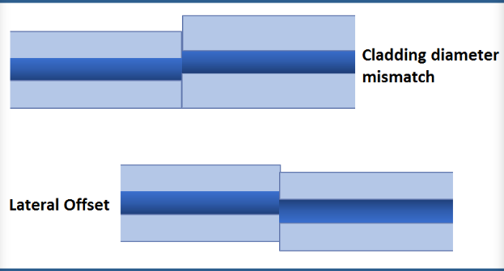
4. INTERCONNECTION LOSS
Interconnection loss associated with splices and connectors can be divided into intrinsic and extrinsic loss. Intrinsic mechanisms are a result of manufacturing tolerances on fiber core diameter, ovality, eccentricity, and numerical aperture. Extrinsic mechanisms depend on the connection hardware and its ability to control the separation between the fiber ends. Transverse, axial, and angular misalignment of the fiber cores results in connector insertion loss.

Slide 21
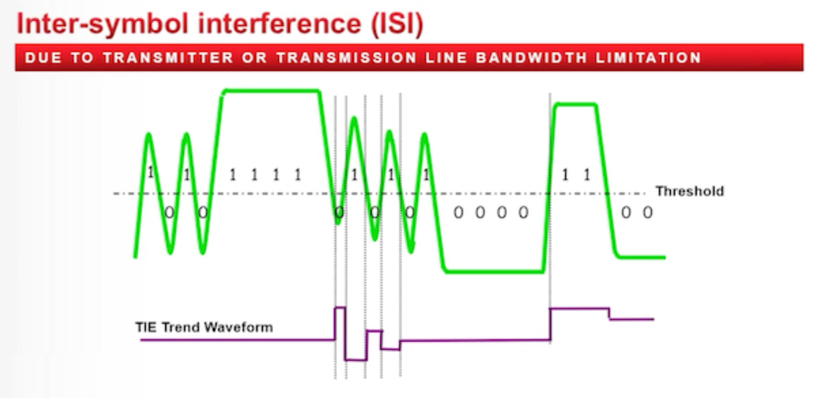
5. INTERSYMBOL INTERFERENCE (ISI)
Within the optical fiber, bits of data are represented by pulses of light. Each pulse of light will spread, or disperse, over time as it travels along the length of the fiber. When these spreading pulses overlap, intersymbol interference results. The less intersymbol interference caused by dispersion, the greater the fiber’s capacity to transmit information. There are two main types of dispersion in optical fibers in the local network environment.

Slide 22
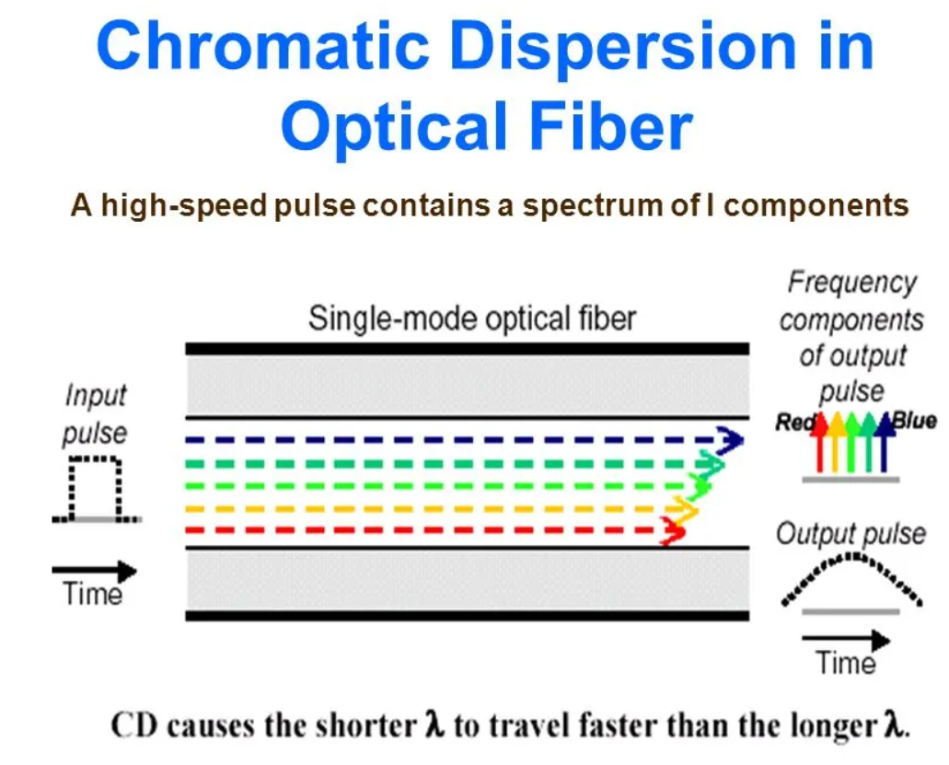
6. CHROMATIC DISPERSION
Chromatic dispersion describes the tendency for different wavelengths to travel at different speeds in a fiber. If operated at wavelengths where chromatic dispersion is high, optical pulses tend to broaden as a function of time or distance and cause intersymbol interference. Although multimode fiber exhibits relatively high chromatic dispersion at the 850 nm wavelength, the use of controlled launch lasers (VCSELs) in gigabit networks and the distances in the LAN minimize the effects.

Slide 23
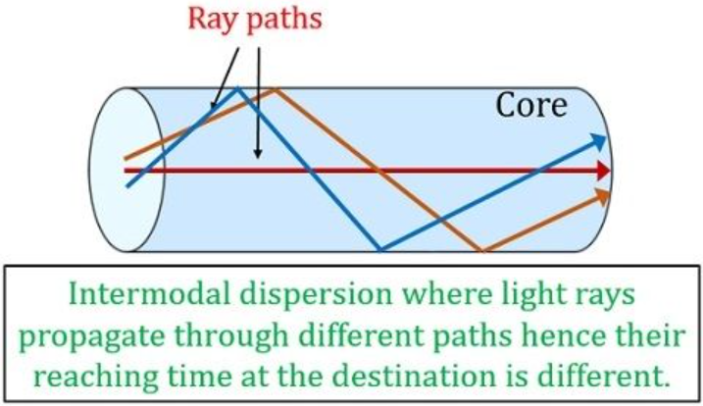
7. MODAL DISPERSION
In multimode fiber systems, the majority of the dispersion is caused by modal dispersion. Modal dispersion exists because the different light rays (modes) have a different optical path length along the fiber; therefore, rays entering at the same time will not arrive at the far end of the fiber at the same time. Light travels faster in the low-index regions near the cladding and slower in the high-index regions near the center of the core. This dispersion effect limits the bandwidth, as shown in the illustrations.

Slide 24
ATTENUATION
Attenuation is the reduction of signal strength or light power over the length of the light-carrying medium. Fiber attenuation is measured in decibels per kilometer (dB/km). Several different factors cause attenuation but primarily scattering and absorption.
• Rayleigh scattering is the largest cause (± 96%) of attenuation in optical fiber. It occurs when light collides with individual atoms in the glass, which knocks it off its original course.
• Absorption accounts for 3 to 5% of fiber attenuation, caused by light being absorbed by
residual materials, such as metals or water ions, within the fiber core and inner cladding. It is these water ions that cause the “water peak” region on the attenuation curve.
• Light leakage due to bending, splices, connectors, or other outside forces is another factor resulting in attenuation.
The ranges of wavelengths at which the fiber operates best are as follows: Each range is known as an operating window.
• Lasers are usually used at 1310 or 1550 nm for single-mode applications.
• On the other hand, LEDs are used at 850 or 1300nm, making them useful for multimode fiber.

Slide 25
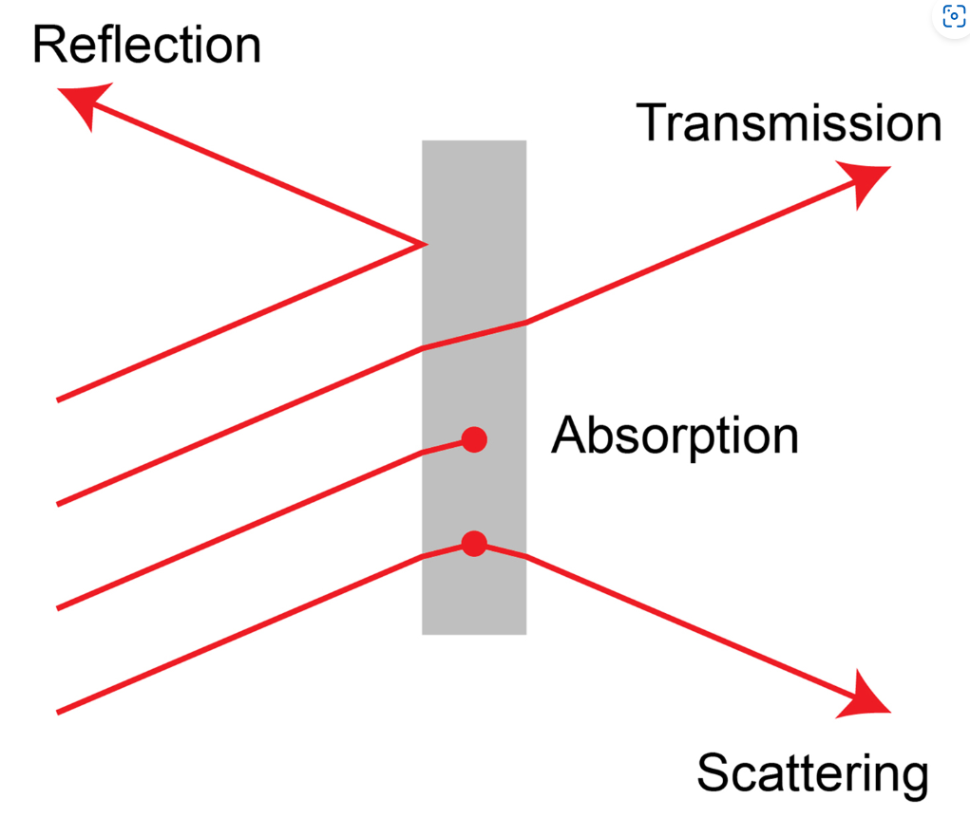
Absorption and Scattering:
Absorption is caused by materials in the glass fiber absorbing light at certain wavelengths, especially with any water left in the glass after processing.
Scattering is a much bigger problem, caused by light hitting molecules, which knocks them off their original course. Scattering is much lower at longer wavelengths, so using the longest wavelengths of light to transmit signals makes sense.

Slide 26
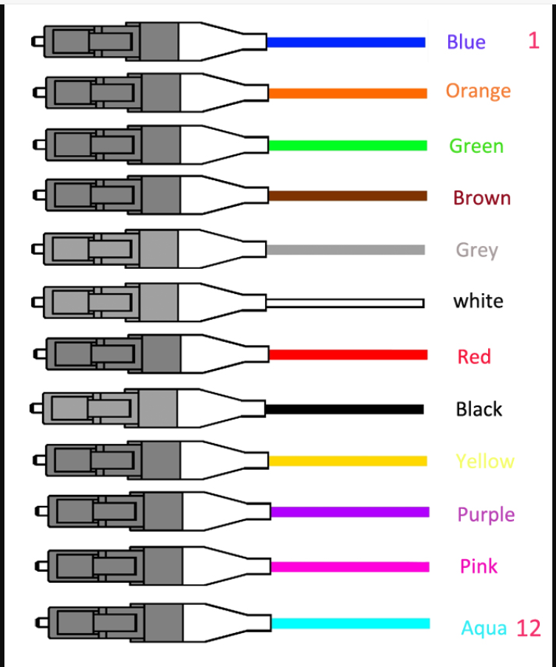

Slide 27
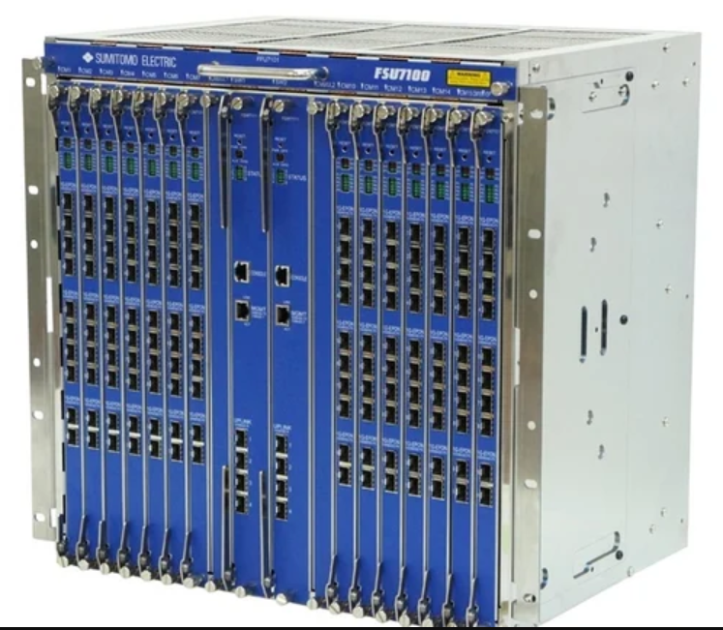
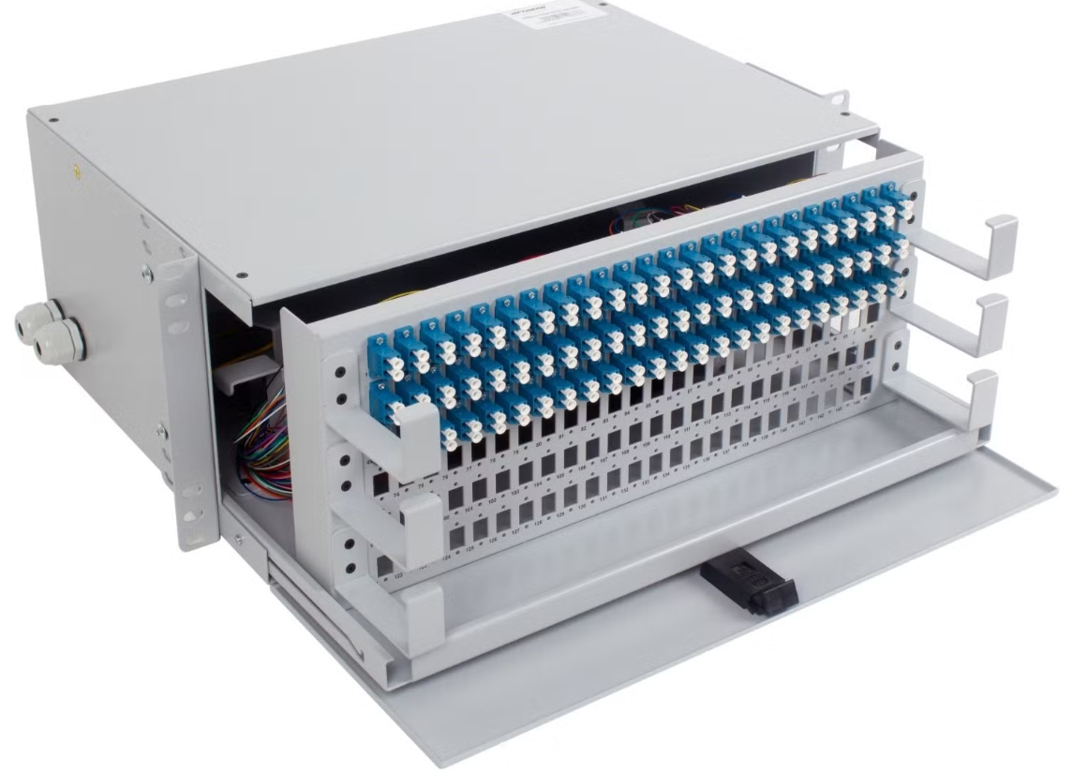
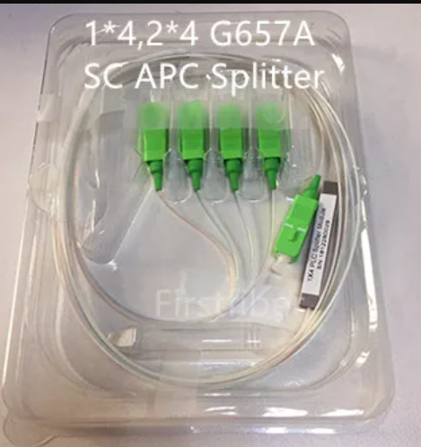
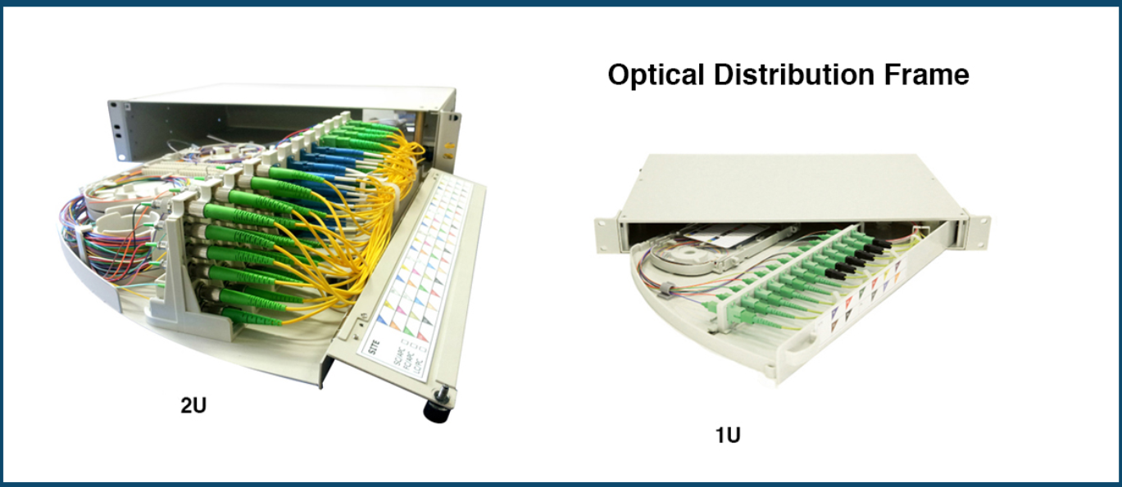
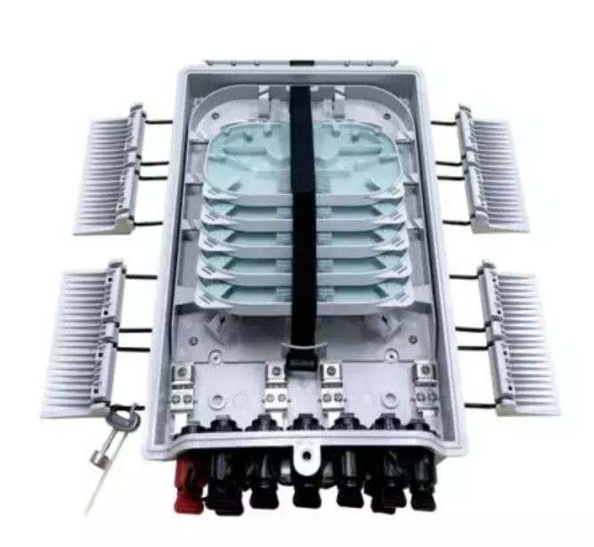
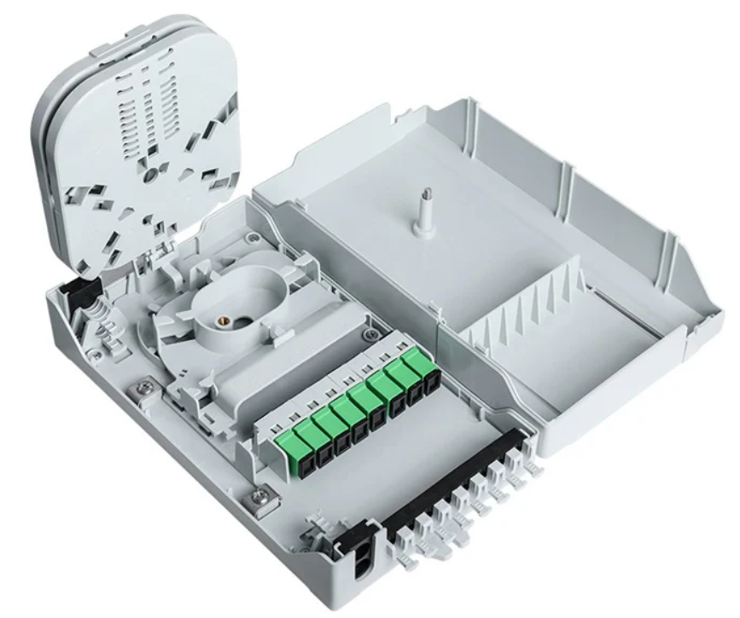
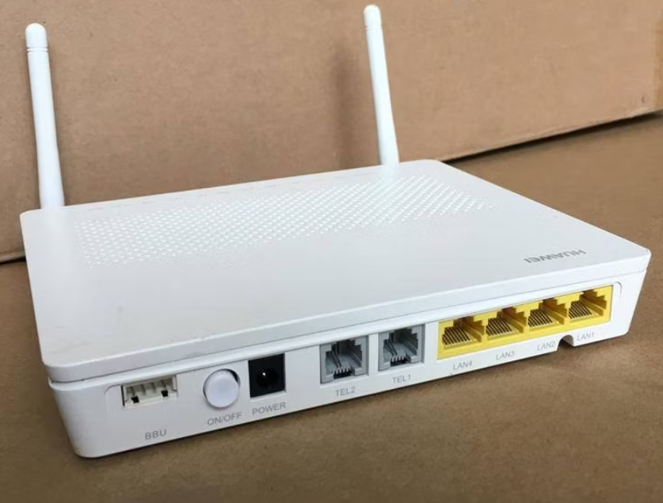
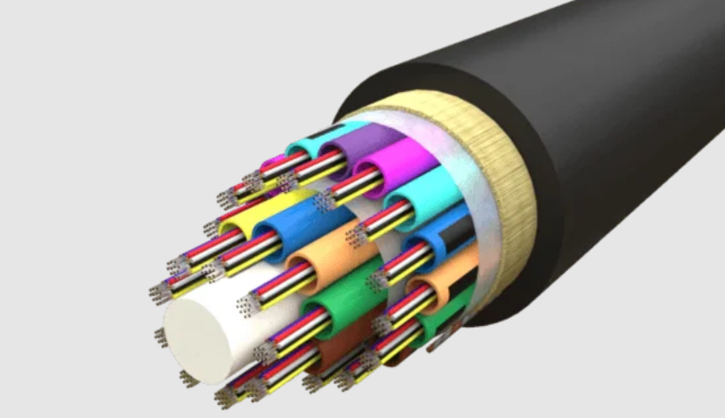
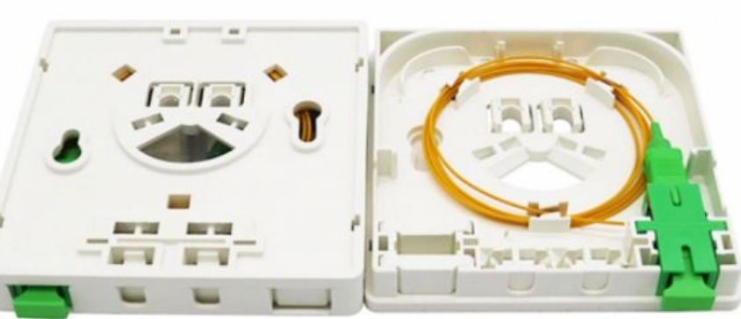
FTTH networks, which bring high-speed internet directly to residential areas, are composed of several key elements. These include the Optical Line Terminal (OLT), pivotal in initiating the fiber optic signal; the Optical Distribution Frame (ODF), which organizes and manages connections; and the Passive Optical Splitter (POS), responsible for dividing the optical signal to serve multiple premises. Additionally, the architecture incorporates Fiber Distribution Terminals (FDT) and Fiber Access Terminals (FAT) for further network distribution, Fiber Terminal Boxes (FTB) for end-user connectivity, along with Optical Distribution Boxes (ODB), Optical Splitter Boxes (OSB), and the Optical Network Units/Terminals (ONU/ONT), which convert optical signals into electrical signals at the user’s premises.
FAT
ODF
OLT
POS
FIBER
OSB
ONU/ONT
FTB

Slide 28
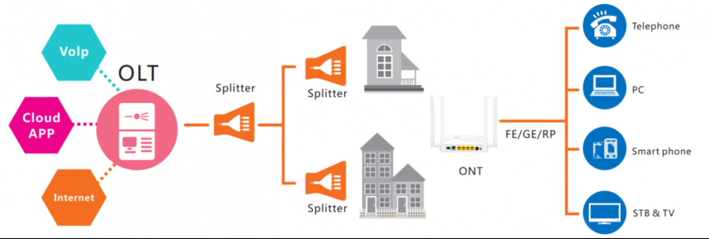

Slide 29



FTTH vs. Other Broadband Technologies
Technology | Medium | Speed | Distance | Reliability
DSL | Copper | Up to 100 Mbps | <5 km | Moderate
Cable | Coaxial | Up to 1 Gbps | <1 km | Good
FTTH | Optical Fiber | 1 Gbps+ | >20 km | Excellent

Slide 30
THANK YOU
Emmanuel Babalola, SD Mainland West

